Slide 1
TRAVELING
AZERBAIJAN STATE OIL AND INDUSTRY UNIVERSITY
Student: Gunel Humbatova
Teacher: Yelena Valiyeva
Faculty: İTİF
Group:604.20E
Notes:
hellooooooooooooooooooooooooooooooooooo

Slide 2
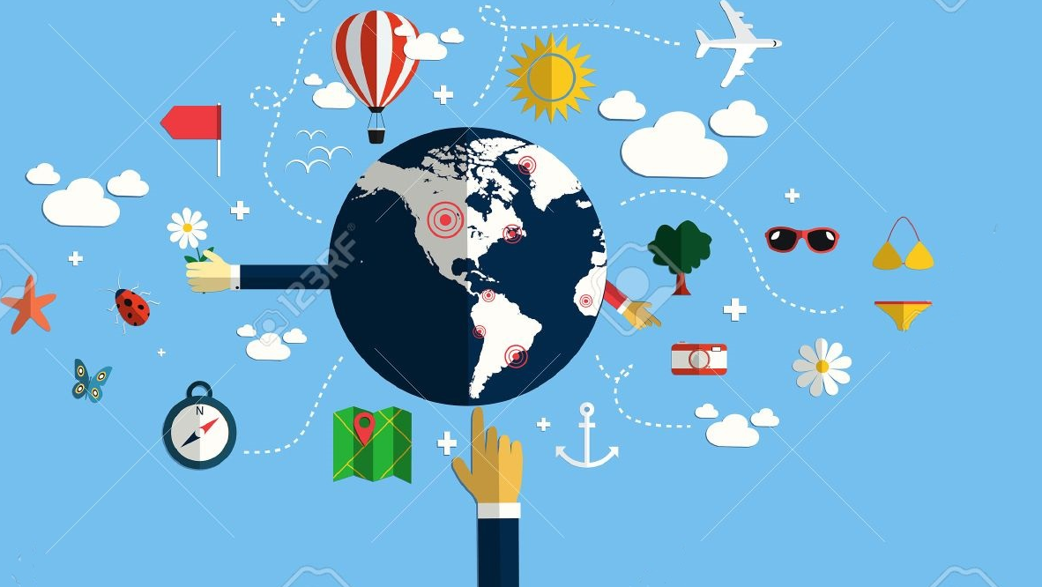
Did you know that travelling can make your life better and happier?
Travelling can teach you more than any university course. You learn about the culture of the country you visit. If you talk to locals, you will likely learn about their thinking, habits, traditions and history as well.

Slide 3

It teaches you about your homeland
You will notice the cultural differences, and will find out what makes your culture unique. After returning from a long journey, you will see your country with new eyes.

Slide 4
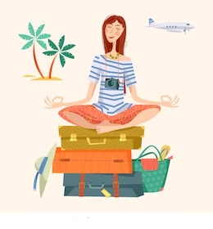
It teaches you about yourself
You can observe how you feel being far from your country. You will find out how you feel about your homeland. You will realize how you really feel about foreign people.
You will be able to observe how you react in completely new situations. You will test your language, orientational and social skills. You will not be the same person after returning home.

Slide 5

It makes you more tolerant
It provides you with unforgettable moments and experiences
You may see beautiful places and landscapes that do not exist where you live. You may meet people that will change your life, and your thinking. You may try activities that you have never tried before.
During travelling you will meet people that are very different from you. If you travel enough, you will learn to accept and appreciate these differences. Traveling makes you more open and accepting.

Slide 6
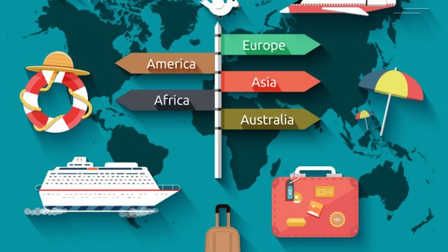
It makes you more confident and independent
You will realize that you can cope with a lot of unexpected situations. You will realize that you can survive without all that help that is always available for you at home. You will likely find out that you are much stronger and braver than you have expected.

Slide 7

It improves your language skills
Even if you go to a country where they speak the same language as you, you may still learn some new words and expressions that are only used there. If you go to a country where they speak a different language, you will learn even more.

Slide 8

It motivates you
After arriving home from a long journey, a lot of travellers experience that they are much more motivated than they were before they left. During your trip you may learn things that you will want to try at home as well. You may want to test your new skills and knowledge. Your experiences will give you a lot of energy.

Slide 9

It provides you with stories you can tell your children and grandchildren
During travelling you may experience the craziest, most exciting things, that will eventually become great stories that you can tell others. When you grow old and look back at your life and all your travel experiences, you will realise how much you have done in your life and your life was not in vain. It can provide you with happiness and satisfaction for the rest of your life.

Slide 10



Our Homeland
It is very gratifying that the heart of our motherland, Karabakh, has been liberated from occupation
i really want to be able to travel there one day

Slide 11

T h a n k y o u
F O R
A t t e n t i o n

